Slide 1

Shri Vaishnav Vidyapeeth Vishwavidyalaya, Indore
Builder Design Pattern
Branch: IT-B
Subject: Computer Network
[BTIT502]
Presented By: Anuj Malviya
[19100BTIT06615]

Slide 2

Contents
Introduction
Problem & Solution
Basic Classes Used
Advantages and Disadvantages
Summary

Slide 3
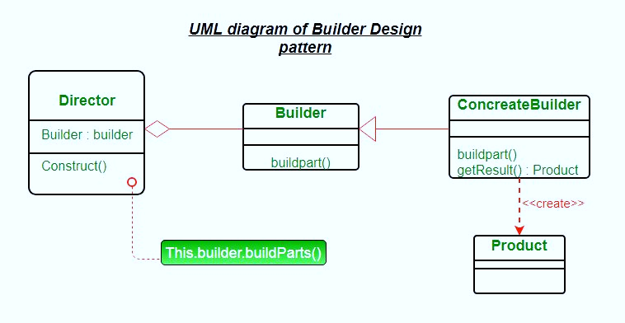
Introduction
Builder pattern aims to “Separate the construction of a complex object from its representation so that the same construction process can create different representations.”
It is used to construct a complex object step by step and the final step will return the object.
The process of constructing an object should be generic so that it can be used to create different representations of the same object.

Slide 4
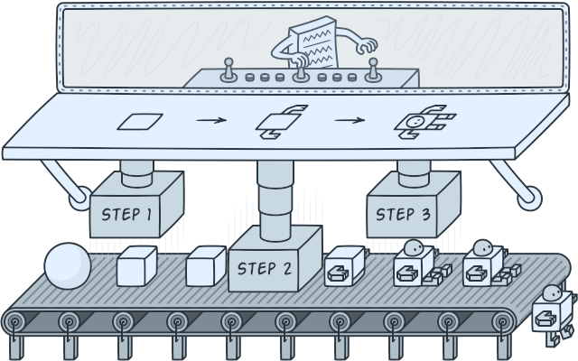
Introduction
Builder is a creational design pattern that lets you construct complex objects step by step. The pattern allows us to produce different types and representations of an object using the same construction code.

Slide 5
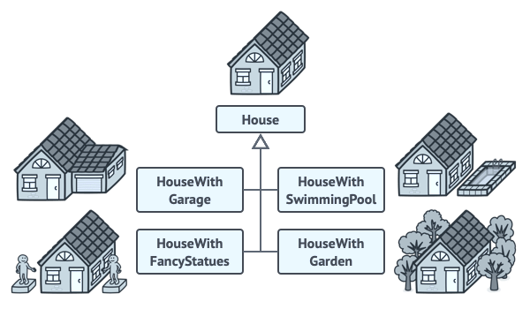
Problem
Imagine a complex object that requires laborious, step-by-step initialization of many fields and nested objects. Such initialization code is usually buried inside a monstrous constructor with lots of parameters. Or even worse: scattered all over the client code.
We might make the program too complex by creating a subclass for every possible configuration of an object.
There’s another approach that doesn’t involve breeding subclasses.

Slide 6
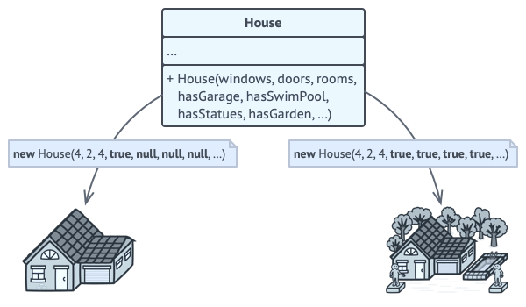
Problem
We can create a giant constructor right in the base House class with all possible parameters that control the house object. While this approach indeed eliminates the need for subclasses, it creates another problem.
The constructor with lots of parameters has its downside: not all the parameters are always needed.
In most cases most of the parameters will be unused, making the constructor calls pretty ugly. For instance, only a fraction of houses have swimming pools, so the parameters related to swimming pools will be useless.

Slide 7
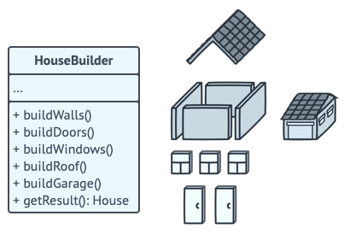
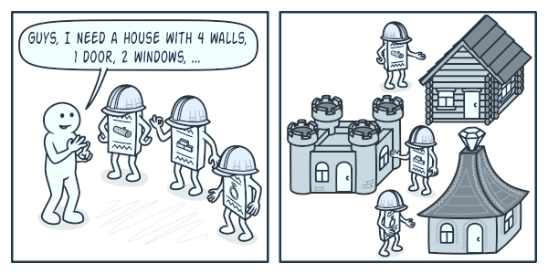
Solution
The Builder pattern suggests that you extract the object construction code out of its own class and move it to separate objects called builders. The Builder pattern lets us construct complex objects by steps.
The Builder doesn’t allow other objects to access the product while it’s being built.
Different builders execute the same task in various ways.

Slide 8
Basic Classes
Product: The product class defines the type of the complex object that is to be generated by the builder pattern.
Builder: This abstract base class defines all of the steps that must be taken in order to correctly create a product.
Each step is generally abstract as the actual functionality of the builder is carried out in the concrete subclasses.
The GetProduct method is used to return the final product. The builder class is often replaced with a simple interface.

Slide 9
Basic Classes
ConcreteBuilder: There may be any number of concrete builder classes inheriting from Builder.
These classes contain the functionality to create a particular complex product.
Director: The director-class controls the algorithm that generates the final product object. A director object is instantiated, and its Construct method is called.
The method includes a parameter to capture the specific concrete builder object that is to be used to generate the product.
The director then calls methods of the concrete builder in the correct order to generate the product object.
On completion of the process, the GetProduct method of the builder object can be used to return the product.

Slide 10
Advantages of Builder Design Pattern
The parameters to the constructor are reduced and are provided in highly readable method calls.
Builder design pattern also helps in minimizing the number of parameters in the constructor and thus there is no need to pass in null for optional parameters to the constructor.
Object is always instantiated in a complete state
Immutable objects can be built without much complex logic in the object building process.

Slide 11
Disadvantages of Builder Design Pattern
The number of lines of code increases at least to double in builder pattern, but the effort pays off in terms of design flexibility and much more readable code.
Requires creating a separate ConcreteBuilder for each different type of Product.

Slide 12
Summary
The application layer is the topmost layer of the protocol hierarchy. It is the layer where actual communication is initiated.
It uses the services of the transport layer, the network layer, the data link layer, and the physical layer to transfer data to a remote host.
In it we have discussed some of the application layer protocols.
We have seen the services in this layer.
Overview of the Application layer
FTP
HTTP
WWW
SSH

Slide 13
REFERENCES
www.google.co
www.wikipedia.org
www.google.co.in.imghp
www.books.google.co.in

Slide 14

THANK YOU

